Slide 1

Module 9 – Parallel Computation Patterns (Reduction)
Lecture 9.2 - A Basic Reduction Kernel

Slide 2
Objective
To learn to write a basic reduction kernel
Thread to data mapping
Turning off threads
Control divergence

Slide 3
Parallel Sum Reduction
Parallel implementation
Each thread adds two values in each step
Recursively halve # of threads
Takes log(n) steps for n elements, requires n/2 threads
Assume an in-place reduction using shared memory
The original vector is in device global memory
The shared memory is used to hold a partial sum vector
Initially, the partial sum vector is simply the original vector
Each step brings the partial sum vector closer to the sum
The final sum will be in element 0 of the partial sum vector
Reduces global memory traffic due to reading and writing partial sum values
Thread block size limits n to be less than or equal to 2,048

Slide 4
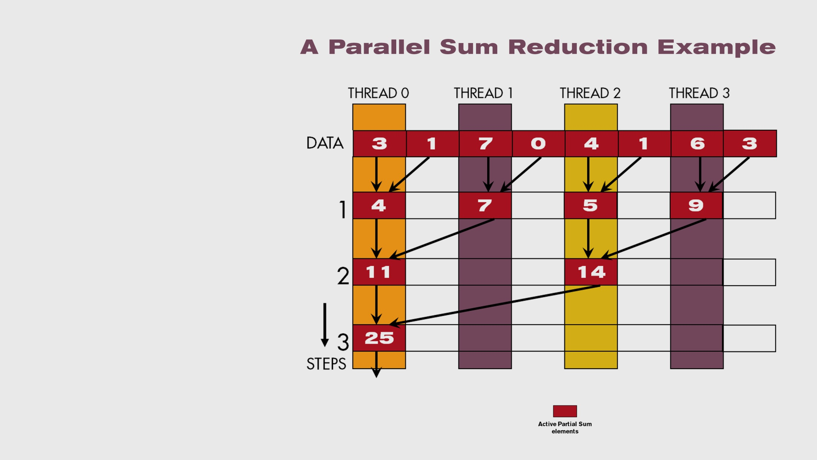
A Parallel Sum Reduction Example

Slide 5
A Naive Thread to Data Mapping
Each thread is responsible for an even-index location of the partial sum vector (location of responsibility)
After each step, half of the threads are no longer needed
One of the inputs is always from the location of responsibility
In each step, one of the inputs comes from an increasing distance away

Slide 6
A Simple Thread Block Design
Each thread block takes 2*BlockDim.x input elements
Each thread loads 2 elements into shared memory
__shared__ float partialSum[2*BLOCK_SIZE];
unsigned int t = threadIdx.x;
unsigned int start = 2*blockIdx.x*blockDim.x;
partialSum[t] = input[start + t];
partialSum[blockDim+t] = input[start + blockDim.x+t];

Slide 7
The Reduction Steps
for (unsigned int stride = 1;
stride <= blockDim.x; stride *= 2)
{
__syncthreads();
if (t % stride == 0)
partialSum[2*t]+= partialSum[2*t+stride];
}
Why do we need __syncthreads()?

Slide 8
Barrier Synchronization
__syncthreads() is needed to ensure that all elements of each version of partial sums have been generated before we proceed to the next step

Slide 9
Back to the Global Picture
At the end of the kernel, Thread 0 in each block writes the sum of the thread block in partialSum[0] into a vector indexed by the blockIdx.x
There can be a large number of such sums if the original vector is very large
The host code may iterate and launch another kernel
If there are only a small number of sums, the host can simply transfer the data back and add them together
Alternatively, Thread 0 of each block could use atomic operations to accumulate into a global sum variable.

Slide 10
The GPU Teaching Kit is licensed by NVIDIA and the University of Illinois under the Creative Commons Attribution-NonCommercial 4.0 International License.

